Slide 1
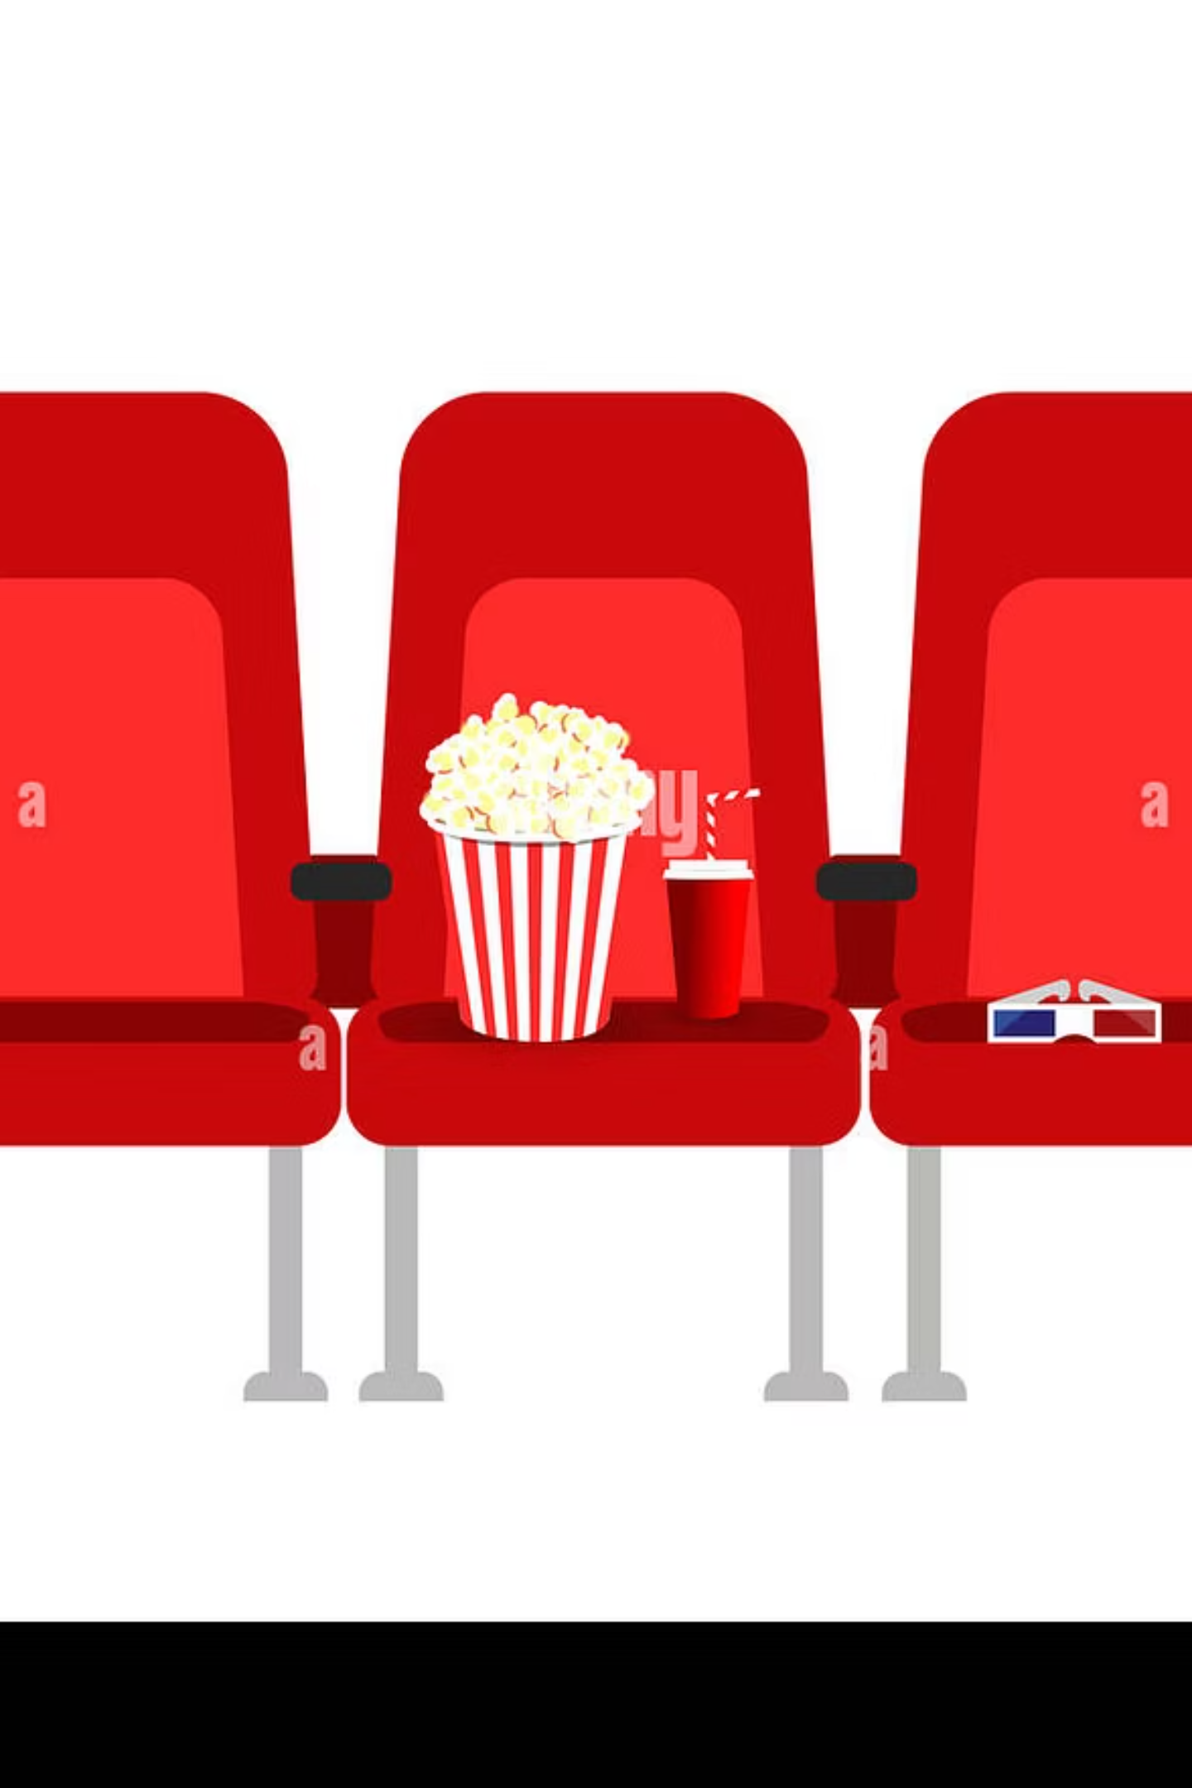
SeatBite
Cinema Food Ordering, Delivered to Your Seat
A full-stack web application built for Saudi Arabia's cinema experience — browse movies, pick your seat, order food and drinks, and track delivery without ever leaving your row.
Team
FIRAS ALMASHAMA
HASSAN ALSHABANAH
AHMED ALROMAIH
MOHAMMED ALAYYASH

Slide 2
The Problem — And How SeatBite Solves It
The Problem
The SeatBite Solution
Cinema customers miss key moments — forced to leave their seats or wait in long concession lines during a screening.
Order directly from your phone. SeatBite supports muvi, AMC, and VOX venues across Saudi Arabia with a seamless flow from movie selection to seat delivery.

Slide 3
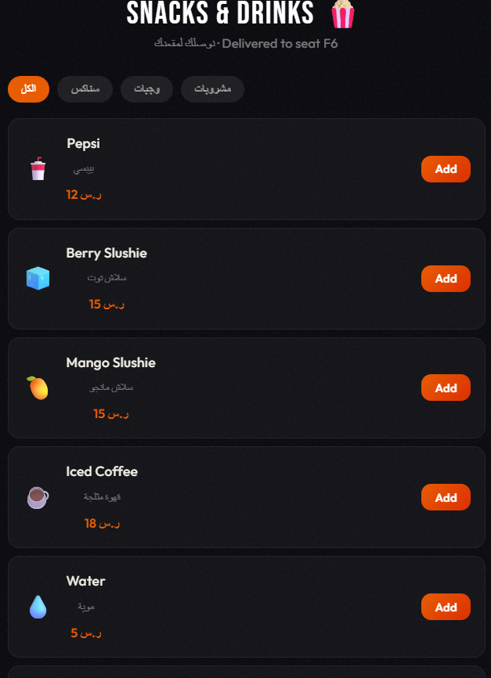
Key Features
Movie & Venue Browsing
Browse movies with English and Arabic filters, then select from real Saudi cinema locations.
Interactive Seat Picker
Live seat availability with taken-seat updates and QR ticket flow for fast ordering.
Bilingual Menu & Cart
Snacks, meals, and drinks with server-calculated totals in English and Arabic.
Mock Payment & Order Tracking
Supports Credit/Debit, Apple Pay, and STC Pay with real-time delivery status: Confirmed → Preparing → On the Way → Delivered.

Slide 4

Technology Stack & Architecture
API — REST (Express)
Frontend — React SPA
Backend — Node.js
Database — MongoDB Atlas
SeatBite uses a decoupled architecture — frontend and backend are separate npm projects communicating through RESTful API calls, each deployed independently.
Frontend
Backend
Database
React + Vite · Responsive SPA
Node.js + Express · REST API
MongoDB Atlas · Mongoose
Auth
Deployment
JWT sessions · bcrypt hashing
Vercel · Render · Atlas

Slide 5
Backend, Database & Security
Database Models
Security Protections
Six Mongoose models power the system:
Password hashing with bcrypt
JWT-based authentication endpoints
Server-side order total calculation
Seat format validation on input
Unique showtime + seat index constraint prevents double booking
Generic login errors reduce email enumeration risk
User
Movie
Venue
MenuItem
Showtime
Order

Slide 6
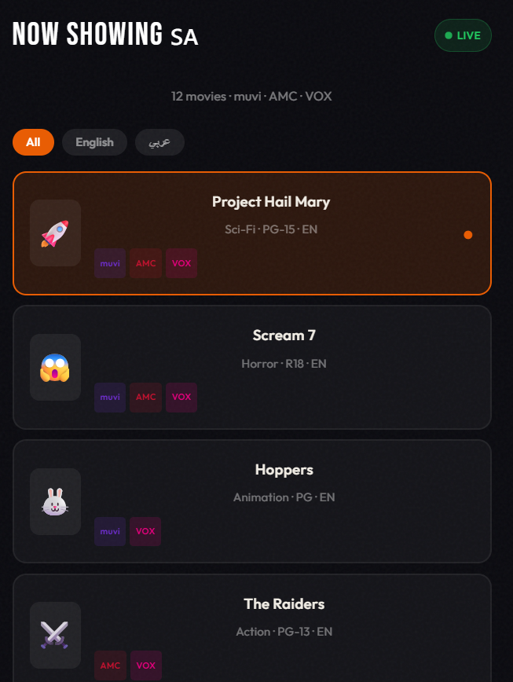

Deployment & Live Demo
Frontend
Backend
Deployed on Vercel — fast CDN, zero-config React builds
Hosted on Render — Node.js API with auto-deploy from Git
Database
Managed on MongoDB Atlas — cloud-native, always-on
SeatBite includes graceful fallback behavior — if the backend is unavailable, the demo continues using local catalog data so the experience never breaks.

Slide 7
Current Limitations & What's Next
Known Limitations
Conclusion
No frontend login UI yet
Apple Pay and STC Pay are mock options
Render backend may have cold-start delays
Showtime selection is automatic
No automated frontend tests yet
SeatBite demonstrates a complete cinema food ordering system — real deployment, live database integration, order tracking, admin tools, and a seamless seat-delivery experience for Saudi cinema audiences.

